Slide 1
The Optimization Problem
Notes:
Once you have a cell that can make a small amount of a chemical, you need to optimize the production to achieve a high-yielding strain to be commercially competitive. This ‘scale-up’ problem is currently the bottleneck step in biosynthetic chemical production, and thus is a common focus of research in synthetic biology and metabolic engineering.

Slide 2
In a nutshell…
Step 1: Augment the organism with a sufficient set of enzymes to convert metabolites already available to the cell into the desired product (or vice versa for catabolism) until activity is detectable
Step 2: Optimize the organism by:
Improving the expression of bottleneck enzymes using directed evolution, truncations, or fusion proteins
Trying homologs of the enzymes used in step 1
Finding the expression level of the enzymes that gives rise to optimal product formation
Knocking-up, down, or out native enzymes to increase flux through the desired pathway
Doing system-wide transposon or chemical mutagenesis and screen for improved yield
Notes:
Device engineering is a two-step process: first we gather up all the genes needed to make the phenotype, then we optimize their expression. Some of these optimization steps involve finding genes that express well to produce high specific activity within the cell. However, much of this process is about optimizing flux from the starting chemical, which is usually glucose, to the product chemical by manipulating the expression of host genes. This problem has received extensive attention because it turns out to be difficult and expensive to perform. Though there have been many valiant efforts to do this computationally, in industry it is primarily a trial and error process that involves directed evolution-like approaches. Today we’re going to go through the theory and experimental approaches to optimizing flux.

Slide 3
Molecules vs Species
Chemical Specie (according to the interweb): “An ensemble of chemically identical molecular entities that can explore the same set of molecular energy levels on the time scale of the experiment”
Specie as it’s normally used in describing cells: a chemically-indistinguishable ensemble of molecules and their count within the system.
It’s a little like saying ‘Compound’ versus ‘Molecule’
A List of 5 molecules
1-butanol
GFP
GFP
1-butanol
1-butanol
A Set of 2 Species:
1-butanol : 3
GFP : 2
Notes:
Let’s start with some basic definitions. The distinction between a molecule and a species is identical to that of instance and class in object oriented programming. A molecule is an instance of a specie. According to the interweb, a species is the ensemble of chemically identical molecular entities that can explore the same set of molecular energy levels on the time scale of the experiment. When we describe the graph that represents a chemical, we are describing the structure of a species. When we speak of individual condensed sets of atoms, we are referring to structures of atoms that are indistinguishable from all others represented by one specie. Thus, we can speak of the count of each specie within the system. If we had these 5 molecules, then there are 2 GFPs and 3 1-butanols. Their count divided by the volume of the container is the concentration of each specie, and it is this value that is being operated upon in most kinetic models of the cell.

Slide 4

(simple) Mass Action Kinetics
1) Write out all the species interacting in the system and their reactions
E
E
k_{f}
E
K_{cat}
S
k_{r}
S
P
“ES Complex”
2) Write a differential equation for each species accounting for the reactions
3) Solve it analytically or numerically (and Michaelis-Menton falls out if you do it analytically with some approximations)
Notes:
You’ve learned from Michaleis menton kinetics that we can describe an enzymatic reaction in terms of an E+S → ES and an ES→E + P step. I have been drawing for you this ES→P step as two distinct ES→EP and an EP→ E+P steps in previous lectures because they are distinguishable and non-concerted microstates. However, it is always possible to aggregate steps into a single one without loss of the essential meaning. If we represent the sequence of events this way, we can write a differential equation to describe each specie’s concentration accounting for the reactions that take place. So, there are 4 distinct species described in the diagram, E, S, ES, and P, so we get
*click*
4 differential equations, and each one has a term associated with one of the arrows in the diagram. Now we are in the math domain where we can
*click*
solve this system of equations. For very simple cases like Michaelis-Menton and its variants, we can solve the system analytically with some simplifying assumptions. We can also solve such systems numerically with little computational difficulty. Suffice it to say, the mathematics for dealing with such systems is well established.

Slide 5
Mass Action Kinetics
A
B
C
P
E1
E2
E3
k_{f1}
K_{cat1}
A+E1
E1A
E1+B
k_{r1}
4 dS/dt equations
3 dE/dt equations
3 dES/dt equations
k_{f2}
K_{cat2}
B+E2
E2B
E2+C
k_{r2}
k_{f3}
K_{cat3}
C+E3
E3C
E3+P
k_{r3}
Notes:
Going from a single enzymatic reaction to a pathway only requires that we describe more species *click*. For this three enzyme system, we’d end up with 10 equations. *click*
Each free substrate accounts for 4 species and 4 equations, each free enzyme accounts for 3 equations and species, and there are 3 complexes to be described for another 3 equations.

Slide 6

Write differential equations that describe the kinetics of this system:

Slide 7
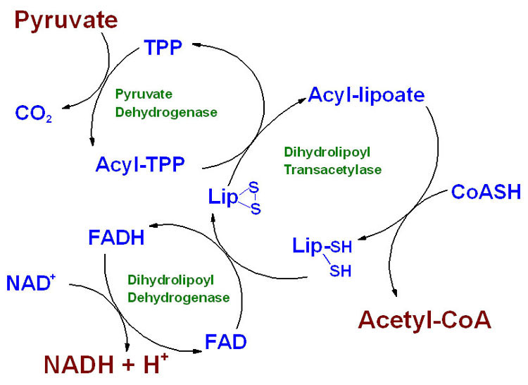
How many species are present in this system?

Slide 8
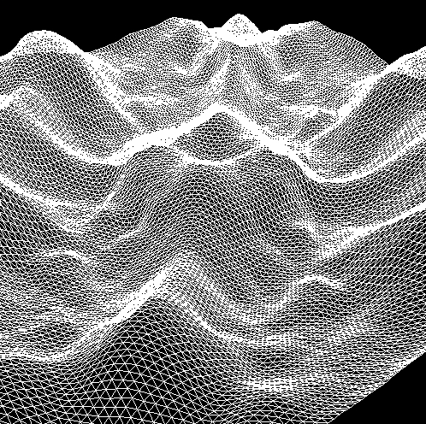
The Energy Landscape
Notes:
When you solve these systems of differential equations you end up with an energy landscape. In this diagram, the valleys represent energy wells corresponding to the stable molecules and complexes we typically observe. The peaks of the mountains represent the transition states between these stable states. They are the barriers that must be overcome to achieve interconversion between these states and thus define the rate at which material flows along this landscape.
*click*
Imagine you took a table contoured with this shape and threw a million tiny balls onto it and shook it. Those balls would fall within local minima within the diagram, but random bouncing would sometimes make them leave these wells and travel to even lower energy wells. If the overall landscape slopes to areas of much lower energy, those balls will naturally undergo their random series of bounces until they encounter that lowest energy state. Such is the same in metabolic engineering. Glucose is entering the cell at a high energy state, and the cell is migrating the atoms in those molecules to lower energy states. The magic of biology is that it is only the case that the net energy of the system must be negative, and there are reactions coupled to other reactions such that you can force the accumulation of intermediates at the expense of the full degradation of other molecules to CO2 and water.

Slide 9
Problems with Kinetic Models
Suppose you knew every reaction occurring within the cell, knew the kcat’s and Km’s for all enzymes involved, and had measured some initial concentrations of each metabolite
You could write a large set of differential equations describing each metabolite as a dS/dt equation that depended on the concentrations of each metabolite with which it interconverts
…and then solve the system of differential equations in the steady state or otherwise
However:
1) Kcat’s and Km’s are mostly unknown. Even substrate range is usually unknown
2) Kinetics of posttranslational mechanisms are unknown
3) Kinetics of transcriptional and translation processes are unknown
Notes:
Suppose you knew every reaction occurring within the cell, you knew the kcat’s and Km’s for all enzymes involved, and had measured some initial concentrations of each metabolite
*click*
You could write a large set of differential equations describing each metabolite as a dS/dt equation that depended on the concentrations of each metabolite with which it interconverts
…and then solve the system of differential equations in the steady state or otherwise
*click*
However, there are several problems associated with doing this today. Basically, we relatively sparse knowledge at the level of granularity needed to satisfy such models. First, Kcat’s and Km’s are mostly unknown. Even substrate range is usually unknown for even well-studied enzymes.
*click*
Also, posttranslational control mechanisms are extensive in the cell, and the Kinetics of posttranslational mechanisms is usually unknown
*click*
We also have very little kinetic data about the full consort of translational and transcriptional processes in the cell and how they interact with the various control factors that respond to metabolites in the cell.
Thus, it is not currently practical to model the cell at this level of detail. Instead, we must make simplifying assumptions.

Slide 10
Flux Balance Analysis
Notes:
If we knew the full kinetic parameters for every enzyme and its concentration in a compartment, knowing the future state of the system is entirely deterministic. We can write differential equations for each specie as it changes over time, then solve those equations, and predict the dynamics.
In practice, we have not yet achieved the ability to exhaustively parameterize all the various rate constants needed to describe biochemical systems at this level of detail. Sure, we can measure things like Kcat and Km for an enzyme in vitro, but they sometimes do not correlate with observed rates in vivo due to matrix effects or localization effects. Also, it’s very expensive in terms of human effort to obtain such data with current practice, thus very little of this data is available. The result of this is that we can only do approximations of this ‘full simulation’ of the system.
Flux balance analysis is a simplification to the massive set of differential equations that could describe the metabolism of the cell. It is one of the most popular methods for modeling the metabolism of the cell.

Slide 11
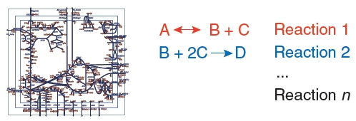
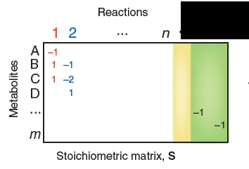
Flux Balance Analysis
http://en.wikipedia.org/wiki/Flux_balance_analysis is particularly good.
Represented by a stoichiometric matrix (S) of size m x n
Have one row for the m compounds in the system
Have one column for each reaction in the system
The entries are the stoichiometric coefficients (positive or negative)
So, this information must be curated but is static
Notes:
In flux balance analysis, we represent the lump sum total of the cells biochemical reactions by a stoichiometric matrix, called S of size m x n.
One row of the matrix has m compounds that exist in the system, and each column represents one reaction that occurs in that system. The values for each cell in the matrix are the stoichiometric coefficients. For example, if a chemical A was converted to B and C, one molecule of A is consumed and two molecules (one b and one c) are generated, thus it is -1 for A and +1 for B and +1 for C. If you have a decent biochemical map of what each enzyme is doing in the cell, you can curate a stoichiometric matrix describing all species and all reactions in the cell.

Slide 12
Write the stoichiometry matrix for the following system:

Slide 13

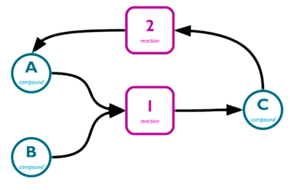
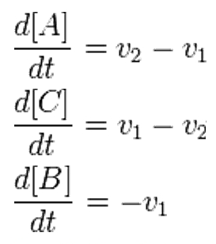
Flux Balance Analysis
The flux is a vector (v) of length n; each reaction has a flux value v_{i}
So, Flux is not the same as dA/dt, since that is an aggregate of several reactions:
2 Reactions
3 Species
Notes:
Suppose I have two enzymes, in pink that interconvert 3 species, A, B, and C. The flux of material through that node in the network is a number in terms of concentration over time. We are used to the ratio of concentration as it changes over time for a specific species, but now we are talking about a rate off flux through an enzyme instead. We can describe our system of enzymes as a vector of length n where n is the number of enzymes. Each value of the vector is this flux through the corresponding enzyme node. We can then describe the change in concentration of each species in terms of these flux values.

Slide 14
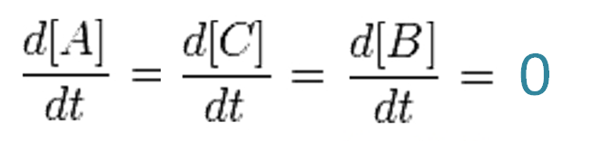
Flux Balance Analysis
The system is assumed to be in a steady state, so dx/dt = 0
Notes:
The system is assumed to be in a steady state – flux is traveling through these nodes, but they have reached some quasi-stable condition in which the flow is balanced out amongst the many reactions. So, dx/dt = 0. Or in other words, the concentration of each chemical is not changing, but change is of course still occurring, it’s just that all change is canceling out.

Slide 15
Flux Balance Analysis
The flux is a vector (v) of length n; each reaction has a flux value v_{i}
So, Flux is not the same as dA/dt, since that is an aggregate of several reactions:
2 Reactions
3 Species
Notes:
Notice that the ‘added info’ to write these differential equations involves adding +1 or -1 stoichiometric terms to each flux term. Thus, each differential equation can be seen as the sum of each stoiometric term multiplied by each flux. Those stoiciometric terms are what we just wrote out in constructing the stoichiometry matrix. If we just make it n-dimensional (for each species), then we can describe the system as just:

Slide 16
Flux Balance Analysis
This can be generalized to:
Many solutions for v exist, and one of them is ‘correct’ (the objective function)
To identify more realistic values, constraints are placed on specific entries in v derived from either thermodynamic or observed values for the flux of specific reactions
It is a new thing to constrain using extensive experimental data, such as ¹³C-MFA or specific NMR methods
Notes:
S times V equals zero. The stoichiometric matrix dot product with the flux vector equals a vector with zero at each position.
*click*
Many solutions for v exist, and one of them is ‘correct’. This ‘real value’ is called the objective function. Unfortunately, there are many solutions to v that would satisfy any S, thus we cannot immediately calculate the ‘real one’.
*click*
To identify more realistic values of the objective function, constraints are placed on specific entries in v derived from either thermodynamic or observed values for the flux of specific reactions
*click*
It is a new thing to constrain using extensive experimental data, such as ¹³C-MFA or NMR methods. The MFA approach involves following an isotopically labeled metabolite through the metabolic map using high-resolution mass spec techniques. Specific NMR methods involve following enriched metabolites or following atoms that are distinguishable by the method such as following fluorinated metabolites.

Slide 17
What do you do with FBA?
Predicting the effects of gene deletions
A single gene in the genome is associated with a small set of reactions
If you were to delete that gene, the values in the stoichiometric matrix become zero
By recalculating the objective function, you can predict the effect of a gene knockout
Predicting the effects of media composition changes
Add additional Species to s to include the new chemicals you have added
See what happens to your target product as a result
Notes:
So what can you do with FBA?
In the context of scale-up optimization, FBA can be used to predict genes whose knockout might improve expression.
A single gene in the genome is associated with a small set of reactions
If you were to delete that gene, the values in the stoichiometric matrix become zero
By recalculating the objective function, you can predict the effect of a gene knockout
*click*
You can also consider what will happen when you take your engineered organism from media composition to another. Here you would add additional Species to the stoichiometry matrix to include the new chemicals you have added, and then look to see what happens to your target product as a result.

Slide 18
Limitations
Because it does not use kinetic parameters, it cannot predict metabolite concentrations
Is only suitable for determining fluxes at steady state
It does not account for regulatory effects such transcriptional control
The reliability of its predictions depends on the accuracy of the stoichiometry data
We don’t in practice know what specific reactions all the enzymes do
The predictions it makes for gene knockouts are usually good for ‘first shell’ predictions.
A
B
C
Y
Notes:
Today, FBA is primarily used as a hypothesis generating tool. It turns out not to be granular enough to make precision predictions, but is very helpful in visualizing how your system works and give you ideas on how to modify it. The root cause of the imprecision is primarily the lack of sufficient kinetic parameters to constrain the objective function.
*click*
FBA also requires a steady state assumption. It is unclear whether this is OK. The media composition, size, shape, and general health of microbes are known to be strained in a bioreactor, and whether a quasi-steady state is an acceptable approximation is unclear.
*click*
Typically these models do not account for regulatory effects simply because so little of that information is available. If such data did exist, it could be accounted for in these models, but you still need the data.
*click*
It is also unclear whether the stoichimetry matrices are correct. They depend on experimental data, which we know to be incomplete and sometimes false. Typically cells are modeled at the level of complexity of a few thousand molecules or much fewer. When cell extracts are measured by high-resolution LC-MS methods, hundreds of thousands of chemicals can be observed. We don’t have a full catalog of the reactions, but perhaps we have the most prominent ones in terms of degree of flux. Thus, it is unclear whether this actually compromises the predictions of FBA.
*click*
The predictions it makes for gene knockouts are usually good for ‘first shell’ predictions. By this, I mean enzymes that immediately divert flux from one of your intermediates. Suppose you have the sequence *click* A→B→C, and there was an enzyme that converted *click* B to Y. FBA can show you these situations and predict that knocking out the B-->Y enzyme will increase flux.

Slide 19
Limitations
Because it does not use kinetic parameters, it cannot predict metabolite concentrations
Is only suitable for determining fluxes at steady state
It does not account for regulatory effects such transcriptional control
The reliability of its predictions depends on the accuracy of the stoichiometry data
We don’t in practice know what specific reactions all the enzymes do
The predictions it makes for gene knockouts are usually good for ‘first shell’ predictions.
Library approaches to this problem are the norm. Very often the ‘right’ things to change in the system (discovered through screening) are unintuitive and are associated with non-enzymatic genes, affecting things like stress and membrane integrity in the cell
Notes:
Library approaches to optimization are usually the norm. When you begin making chassis modifications like knockins and knockouts, you are not only changing the flux through a pathway but also the viability of the organism. The viability of the organism involves its growth rate and and stress effects. These ultimately affect the production efficiency of the fermentation and thus are entangled with this isolated idea of flux optimization. As a result, the mutations that improve performance are often ‘strange’ in the sense that they often have nothing obvious to do with the enzymes in your system. For example, if one of your introduced chemicals accumulates and causes membrane stress and this greatly hampers growth, then improvements to membrane homeostasis are of primary importance. Such aspects of the system are currently beyond the scope of the FBA models.

Slide 20
Optimization of Biosynthesis using MAGE
Wang.pdf
Notes:
MAGE is a technique developed in the Church lab that allows you to install all combinations of a set of specific genome edits to produce a library of organisms. More generally, it is one of the recent power tools for making many edits to a genome. It is most useful for improving the production of chemicals by MCF organisms.

Slide 21
Methods of modifying the genome
Chemical Mutagenesis – different chemicals cause specific types of missense or frameshift mutations. Ex. MNNG, UV light
Transposon Mutagenesis – random integration of a large DNA sequence into arbitrary positions in the genome. It has largely the same effect as randomly adding stop codons.
Homologous Recombination – site-specific targeting of a gene. Can be used for knock-up, knock-down, or knock-out (or other fancier things)
Multiplex Automated Genome Engineering (MAGE) – the new method. Involves making many explicit edits to the genome using oligos
Notes:
There are many degrees to which we can target modifications to a genetic design to improve its performance. At one end of the spectrum are entirely random approaches. Subjecting a cell to chemical mutagens such as MNNG will introduce random point mutations to the genome. If you screen enough mutants, you typically will find something that boosts performance. Transposon mutagenesis similarly involves random modifications to the genome. Here, you transfer a DNA that inserts itself into random sites of the genome. Whenever the transposon inserts into a gene, its function is oblated by disruption of the protein sequence. Homologous recombination, also called recombineering or often specifically lambda red mutagenesis involves using synthetic oligonucleotides to target modifications to a specific site of the genome. Thus, it is a highly-specific method allowing you to make precision modifications to the genome.
*click*
MAGE is a technique developed by George Church’s lab that marries the randomness of chemical and transposon mutagenesis with the precision of homologous recombination. It uses the same chemistries as homologous recombination techniques, but you do many such knockouts in parallel and have control over the sequence identity of each modification of the library. It allows you to examine all the combinations of a set of genome edits as a library.

Slide 22
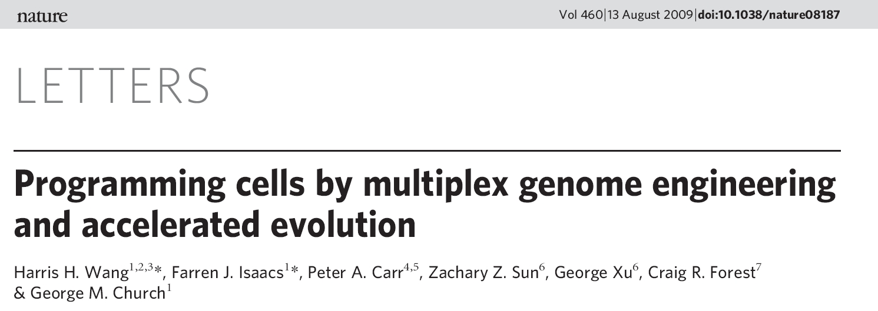
PMID:19633652
Notes:
In this paper, Wang and coworkers show that you can rapidly improve the production of a secondary metabolite through MAGE and screens.

Slide 23
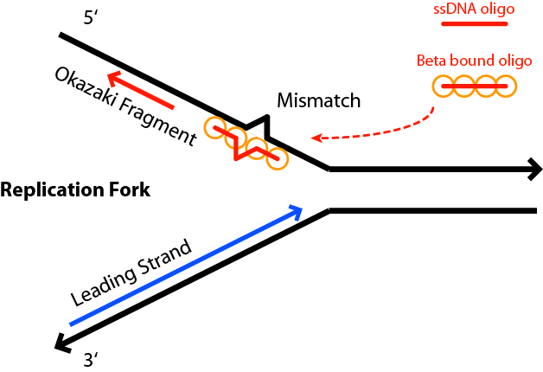

Oligo-based Recombineering
mismatch
Notes:
In the E. coli MAGE experiment, you start with a strain engineered with the lambda red genes from the phage and a mutation to the mutS gene. One of the reasons people like to work with E. coli is that it does homologous recombination ineffeciently. Introduced DNAs are thus very stable in the organism. When you add the lambda red genes, this functionality is provided and homologous recombination becomes highly efficient. The mutS knockout prevents the repair of mismatches in the genome thereby increasing the efficiency of the process.
In the MAGE method, you transform these cells with single-stranded DNAs. During replication, a transient dissociated DNA exists at the site of replication forks. The oligo can anneal to the DNA in these regions and become incorporated into the sequence.

Slide 24
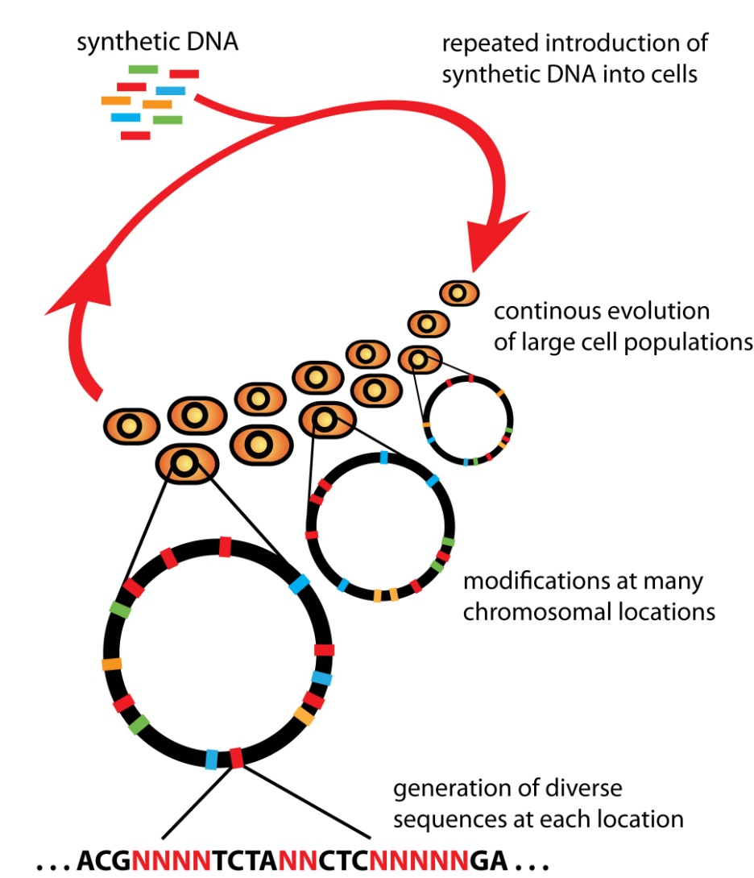

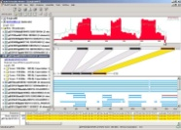
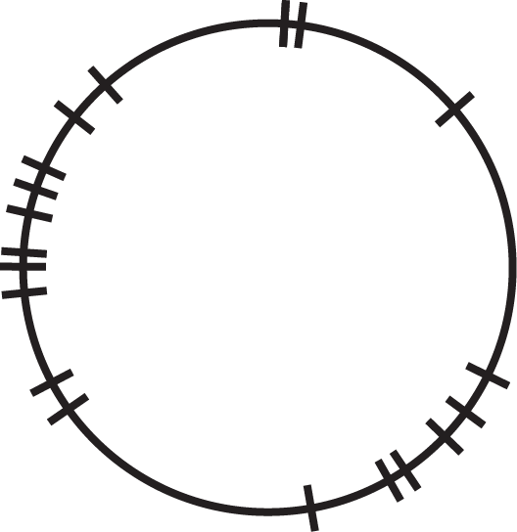
Multiplex Automated Genome Engineering (MAGE)
in silico design
MG1655
genome
24 chromosomal targets,
simultaneously modified
Notes:
Operationally, MAGE involves in silico methods to design a set of Oligos that are synthesized by conventional methods. The cells are repeatedly electroporated with this mix of oligos, and at each step a small fraction of the cells picks up another one of these mutations. After doing this perhaps 10 times, a large number of mutations accumulates in each genome.
*click*
In this study, they choose 24 chromosomal targets that they anticipate are related to production of their target chemical, and design an oligo for each site, then use those oligos for MAGE.

Slide 25
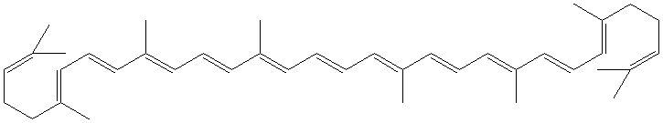
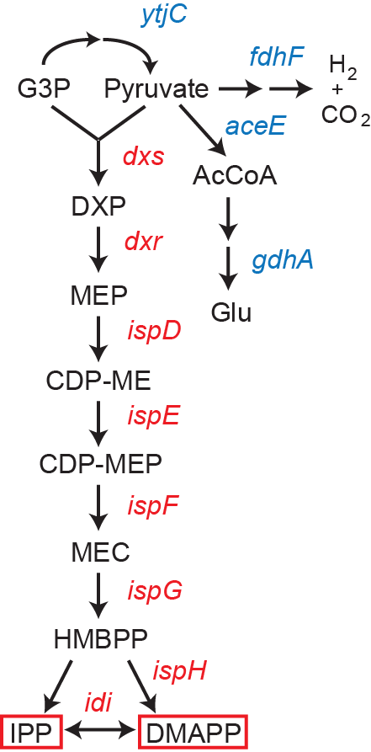
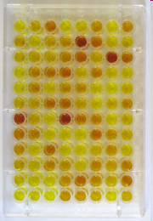
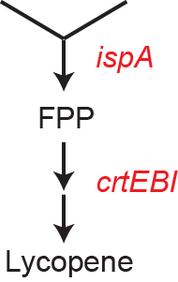
Lycopene (C40) Biosynthesis & Optimization
TAKE SUPERSET OF PUTATIVELY RELEVANT GENES
dxs dxp biosynth
dxr dxp biosynth
ispD/F dxp biosynth
ispE dxp biosynth
ispG dxp biosynth
ispH dxp biosynth
idi dxp biosynth
ispA dxp biosynth (secondary)
yhbL putative isoprenoid biosynth
rpoS RNAP σS
crl regulates activity/abundance of RNAP σS
appY DNA binding transcription factor
ycgW inhibits proteolysis of stationary phase σ factor
yjiD inhibits proteolysis of stationary phase σ factor
yfjN RnaseLS, general RNA degradation
purHD purine biosynthesis gene
yggT predicted inner membrane protein
ycgZ predicted protein
ymgA protein involved in biofilm formation
ymgB regulator of acid resistance
screen for improved mutants
isoprenoid precursors
Notes:
The target in this study was lycopene production which involves addtion of the crtE, crtB, and crtI genes from another bacterium. It is a terpenoid that branches off of FPP.
*click*
They chose mutations to all the genes upstream of FPP as well as others related to terpenoid production.
*click*
From the MAGE library they screened individual colonies for increased pigment production. Lycopene is a convenient target in this study because it is a chromophore, and its production can be read out by just looking at the color intensity of a colony. However, most chemicals we produce do not have this property and are more difficult to screen. When the phenotype in question is readily screened, MAGE is an excellent choice for optimization.

Slide 26
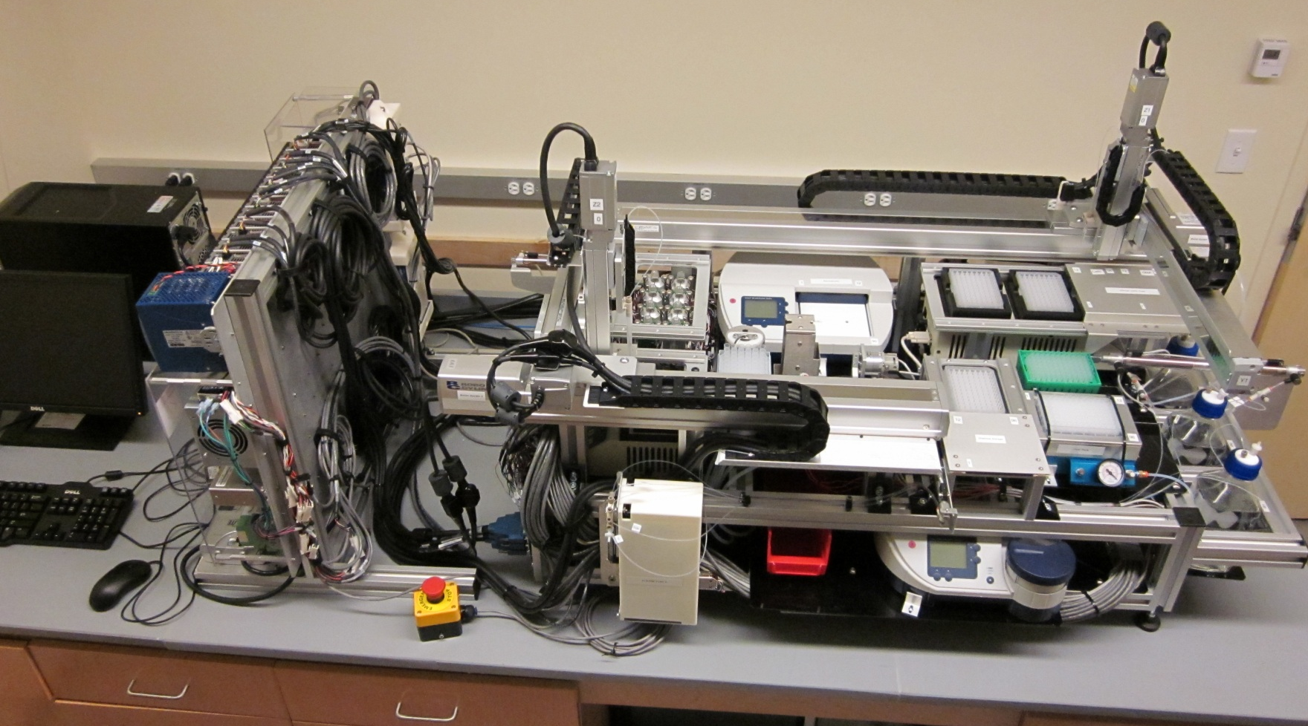
MAGE v3.0: general GE platform
Notes:
In addition to the lambda red bioware in MAGE, there is also an automation setup. The manipulations involve growing a population of cells to an appropriate concentration, induce the allelic replacement machinery inside the cells, remove the growth media, introduce pools of DNA into the cells by electroporation, and recover the cells for the next iteration of the cycle.
The cycle time is about 2 hours and can generate genetic modifications in as much as 30% of the entire population every cycle. Here we see the next-generation apparatus for performing MAGE. It contains environmentally controlled growth chambers, antifouling fluidic systems and buffer exchange units and an automated electroporation device to introduce DNA into the cells continuously.

Slide 27
Optimization of biosynthesis using promoter libraries
Wang.pdf
Notes:
Optimization involves a combination of edits to the genome as well as edits to the device being introduced into the cell. Typically the modifications to the device are regulatory in nature such as the swapping out of promoters.

Slide 28
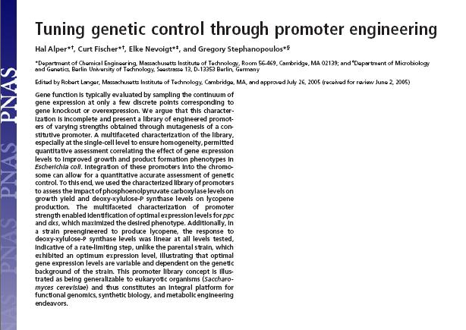
PMID 16123130
Notes:
In this study, Hal Alper and coworkers show that you can tune a biosynthetic pathway to different yields by systematically changing the promoters in front of genes.

Slide 29
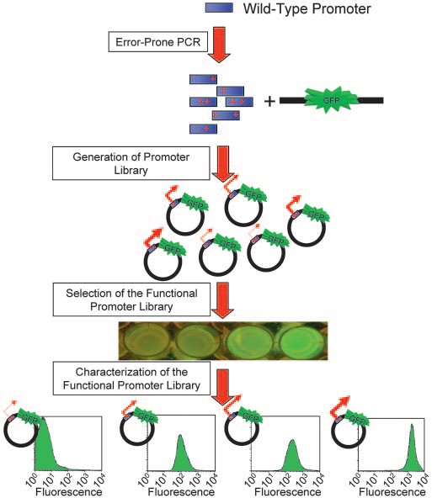
Identification of a promoter family
Notes:
For this, they needed to generate a promoter library. They began with a wild-type promoter sequence and introduced mutations to it by error-prone PCR. They then subcloned this library in front of a GFP gene to make a promoter library. They then screened through this library to identify variants that had multiple distinct transcription levels and characterized the relative strength of each promoter using cytometry.

Slide 30
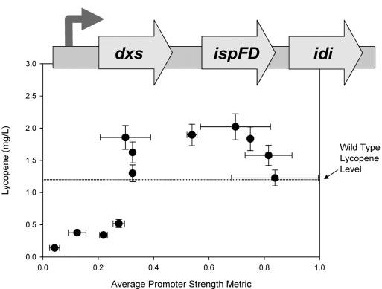
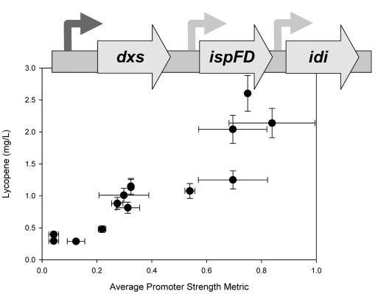
Tuning expression levels
Notes:
They could then use these promoters to tune the expression of genes in a carotenoid biosynthetic pathway. In the left chart, each datapoint represents a biosynthetic pathway in which the promoter has the strength described by the X axis. The amount of lycopene production is quantified in the Y axis. You can see that there is a broad optimum expression level to this pathway. On the right, they put each gene under its own promoter and just vary the first enzyme’s promoter. Here, you do not see the same optimum. This general approach is currently a highly popular approach for improving production through optimal expression of the genes in a device.

